Slide 1
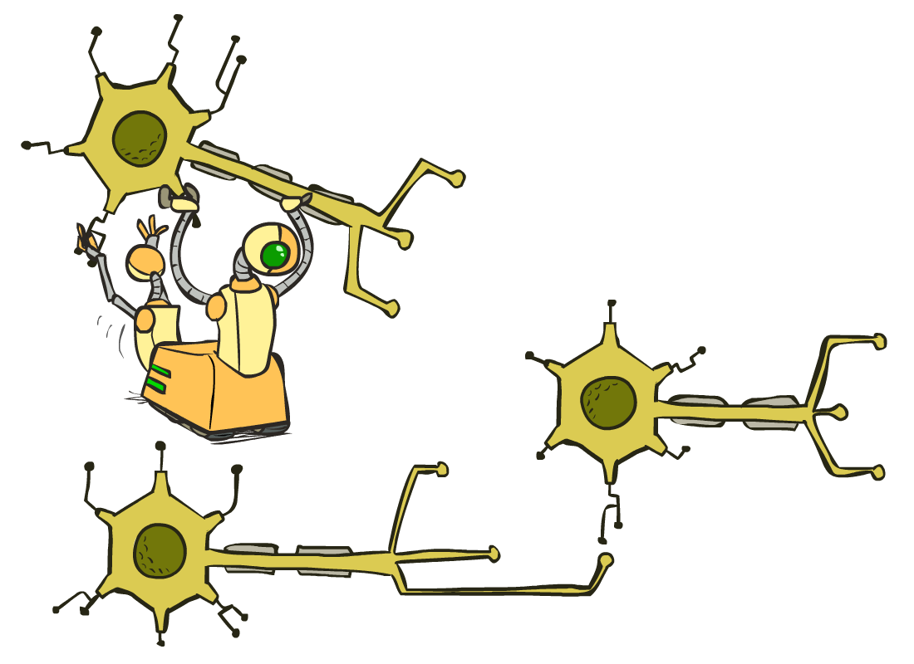
CS 188: Artificial Intelligence
Neural Nets
Instructor: Stuart Russell and Dawn Song --- University of California, Berkeley
Notes:
Please retain proper attribution, including the reference to ai.berkeley.edu. Thanks!

Slide 2
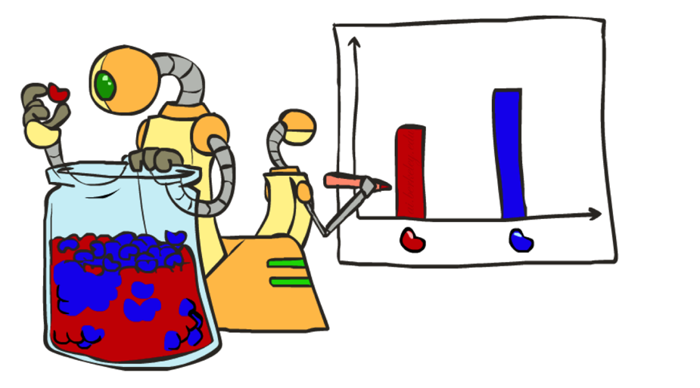
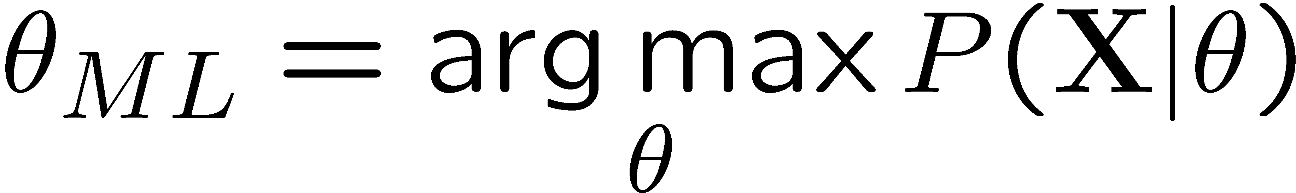
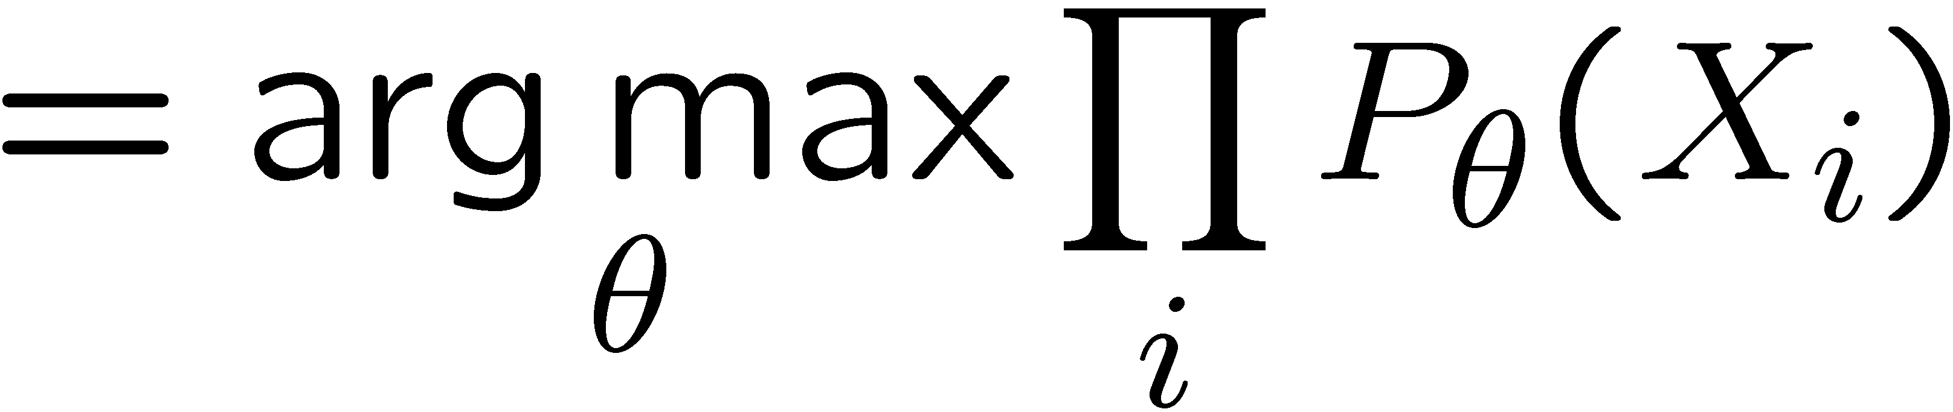
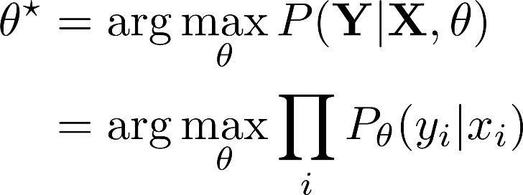
Recap: Maximum Likelihood Estimation
Learning = Bayesian updating of a probability distribution over H
Prior P(H), training data X
Maximum likelihood estimation
Maximum conditional likelihood estimation
How to solve for ⍬_{ML}?

Slide 3
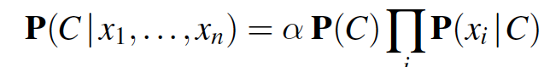
Recap: Naïve Bayes
Naïve Bayes model:
Attributes conditionally independent of each other, given the class
Assuming there are 2 classes, n Boolean attributes X_{i}, how many parameters are in this Naïve Bayes model?
Maximum likelihood parameter estimation
Inference: what’s the class given attribute values (x_{1,} …, x_{n})?

Slide 4
Bayesian learning
Learning = Bayesian updating of a probability distribution over H
Prior P(H), training data X=x₁,...,x_{N}
Given the data so far, each hypothesis has a posterior probability:
P(h_{k}|X) = α P(X|h_{k})P(h_{k}) = α x Likelihood x Prior
Predictions use a likelihood-weighted average over the hypotheses:
P(x_{N+1}|X) = Σ_{k} P(x_{N+1}|X,h_{k})P(h_{k}|X) = Σ_{k} P(x_{N+1}|h_{k})P(h_{k}|X)
No need to pick one best-guess hypothesis!
Drawback: Σ_{k} may be expensive/impossible for large/infinite H

Slide 5
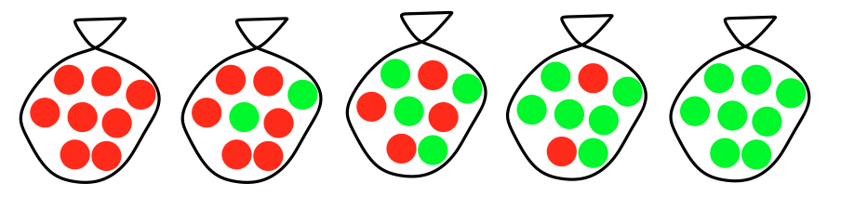

Example: Surprise Candy Co.
Suppose there are five kinds of bags of candies, no labels!!
10% are h1: 100% cherry candies
20% are h2: 75% cherry candies + 25% lime candies
40% are h3: 50% cherry candies + 50% lime candies
20% are h4: 25% cherry candies + 75% lime candies
10% are h5: 100% lime candies
Then we observe candies drawn from some bag:
What kind of bag is it?
What flavour will the next candy be?

Slide 6
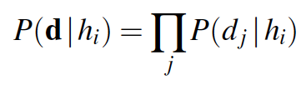
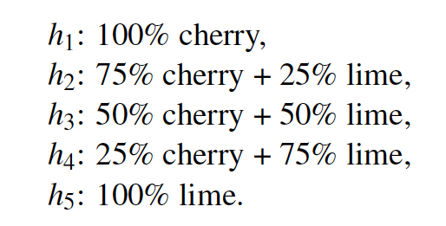
Posterior probability of hypotheses
Prior over h₁, …, h₅: <0.1, 0.2, 0.4, 0.2, 0.1>
P (h_{k}|X) = α P(X|h_{k})P(h_{k})
P(h1 | 5 limes) = αP(5 limes | h1) P(h1 )= _________________
P(h2 | 5 limes) = αP(5 limes | h2) P(h2) = __________________
P(h3 | 5 limes) = αP(5 limes | h3) P(h3) = ___________________
P(h4 | 5 limes) = αP(5 limes | h4) P(h4) = ____________________
P(h5 | 5 limes) = αP(5 limes | h5) P(h5) = ___________________
α = ___________________
h1 h2 h3 h4 h5

Slide 7
Posterior probability of hypotheses
P (h_{k}|X) = α P(X|h_{k})P(h_{k})
P(h1 | 5 limes) = αP(5 limes | h1) P(h1 )= α · 0.0 ⁵· 0.1 = 0
P(h2 | 5 limes) = αP(5 limes | h2) P(h2) = α · 0.25⁵ · 0.2 = 0.000195 α
P(h3 | 5 limes) = αP(5 limes | h3) P(h3) = α · 0.5⁵ · 0.4 = 0.0125 α
P(h4 | 5 limes) = αP(5 limes | h4) P(h4) = α · 0.75⁵ · 0.2 = 0.0475 α
P(h5 | 5 limes) = αP(5 limes | h5) P(h5) = α· 1.0⁵ · 0.1 = 0.1 α
α = 1/(0 + 0.000195 + 0.0125 + 0.0475 + 0.1) = 6.2424
P(h1 | 5 limes) = 0
P(h2 | 5 limes) = 0.00122
P(h3 | 5 limes) = 0.07803
P(h4 | 5 limes) = 0.29650
P(h5 | 5 limes) = 0.62424

Slide 8
Posterior probability of hypotheses

Slide 9
Prediction probability
P(x_{N+1}|X) = Σ_{k} P(x_{N+1}|h_{k})P(h_{k}|X)
P(lime on 6 | 5 limes)
= P(lime on 6 | h1)P(h1 | 5 limes)
+ P(lime on 6 | h2)P(h2 | 5 limes)
+ P(lime on 6 | h3)P(h3 | 5 limes)
+ P(lime on 6 | h4)P(h4 | 5 limes)
+ P(lime on 6 | h5)P(h5 | 5 limes)
= 0×0 + 0.25×0.00122 + 0.5×0.07830 + 0.75×0.29650 + 1.0×0.62424
= 0.88607

Slide 10
Prediction probability

Slide 11
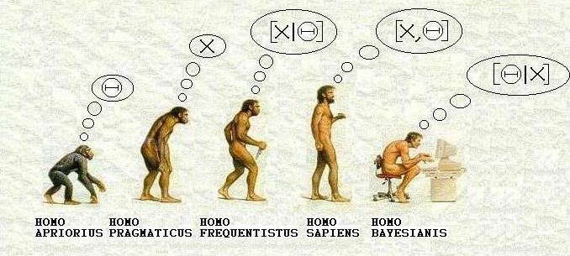
Bayesian learning
Notes:
Bayesian as the most sophisticated (and most computationally expensive). It's a little bit cryptic but
X means just the raw data (e.g., tabulated counts) with no statistical inference at all, which was the rule in the 18th and 19th century (back then, statistics meant exactly that: counts but no predictions at all);
X|Theta is maximum likelihood or frequentist (finding Theta* maximizing P(X|Theta));
X,Theta is maximum a priori (finding Theta* maximizing P(X,Theta) = P(X|Theta)P(Theta) )

Slide 12
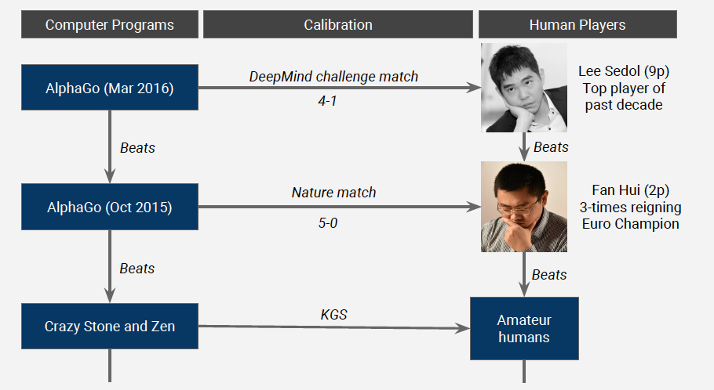

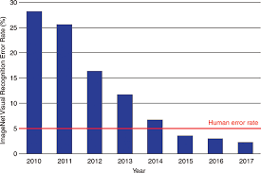
Deep Learning/Neural Network
Image Classification

Slide 13
Very loose inspiration: Human neurons

Slide 14
Simple model of a neuron (McCulloch & Pitts, 1943)
Inputs a_{i} come from the output of node i to this node j (or from “outside”)
Each input link has a weight w_{i,j}
There is an additional fixed input a₀ with bias weight w_{0,j}
The total input is in_{j} = Σ_{i} w_{i,j} a_{i}
The output is a_{j} = g(in_{j}) = g(Σ_{i} w_{i,j} a_{i}) = g(w.a)
Notes:
fix notation: x, a, h, etc, explain bias

Slide 15
Activation functions g
Threshold
Sigmoid 1/(1+e^{-x})

Slide 16
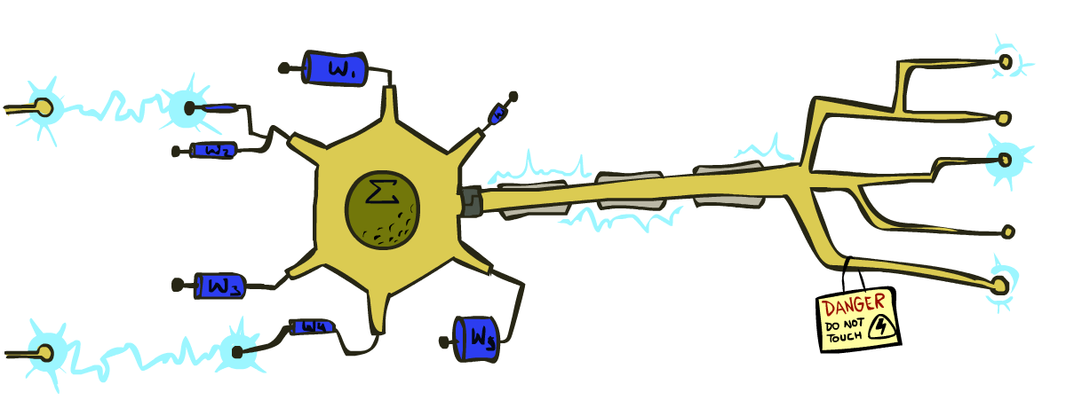
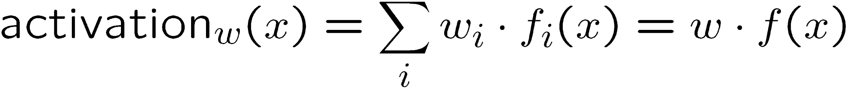
Reminder: Linear Classifiers
Inputs are feature values
Each feature has a weight
Sum is the activation
If the activation is:
Positive, output +1
Negative, output -1
w₁
f₁
Σ
w₂
>0?
f₂
w₃
f₃

Slide 17
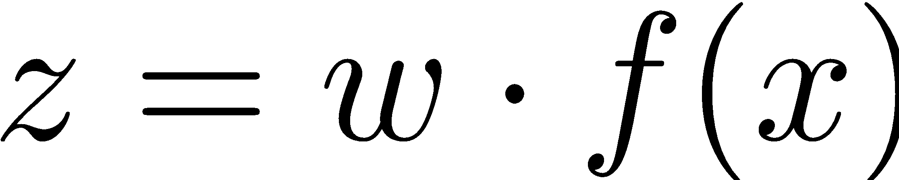
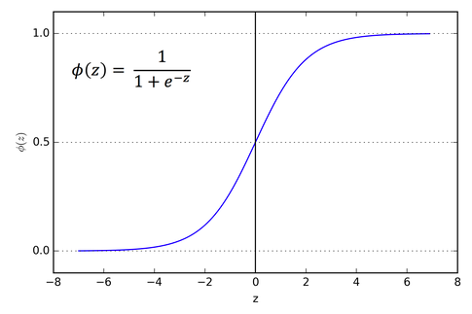
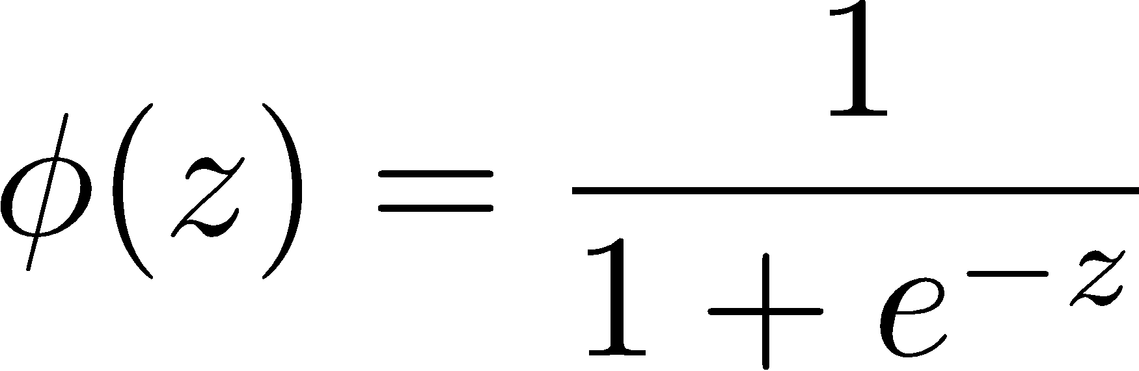
How to get probabilistic decisions?
If very positive, want probability going to 1
If very negative, want probability going to 0
Sigmoid function

Slide 18
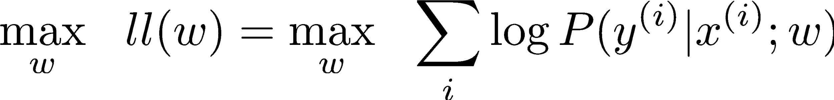
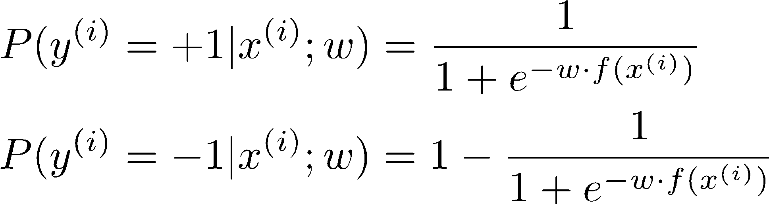
Best w?
Maximum likelihood estimation:
with:
= Logistic Regression

Slide 19
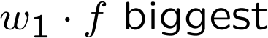


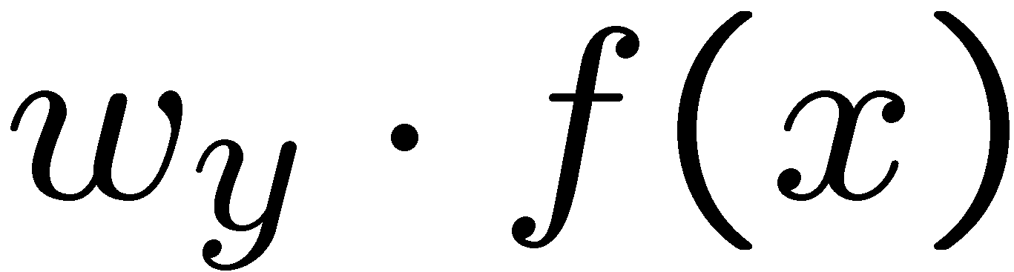


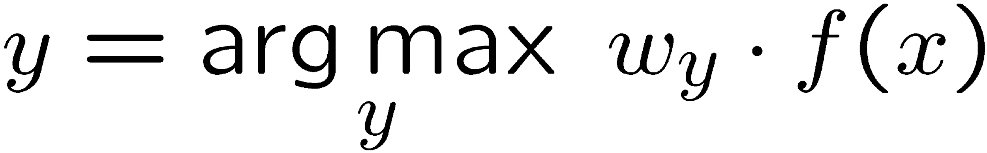
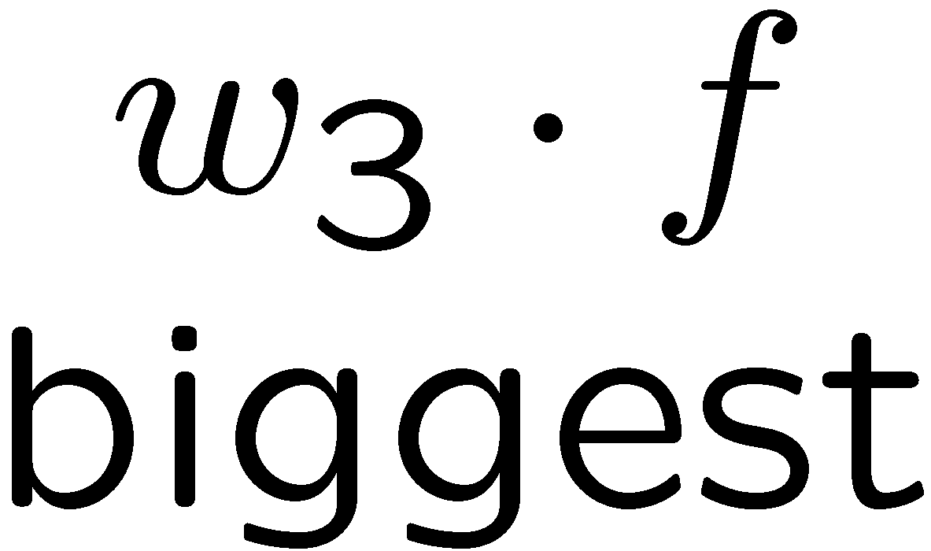
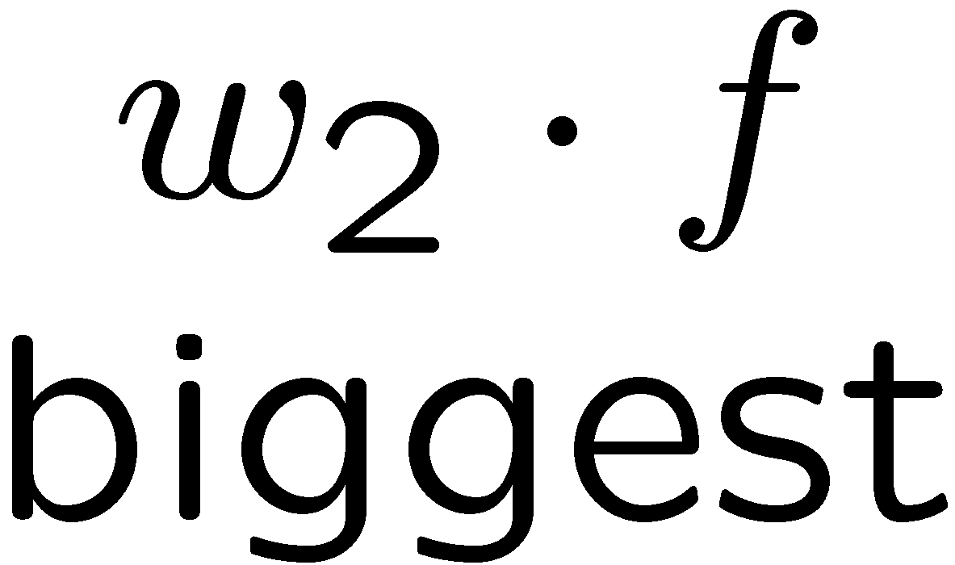
Multiclass Logistic Regression
Multi-class linear classification
A weight vector for each class:
Score (activation) of a class y:
Prediction w/highest score wins:
How to make the scores into probabilities?
original activations
softmax activations

Slide 20
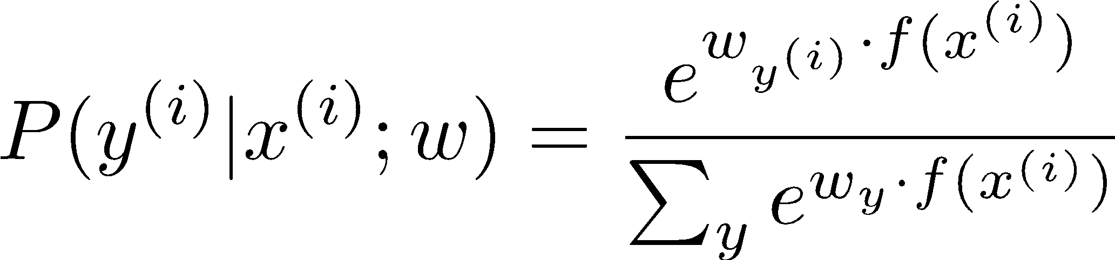
Best w?
Maximum likelihood estimation:
with:
= Multi-Class Logistic Regression

Slide 21
Optimization
Optimization
i.e., how do we solve:

Slide 22
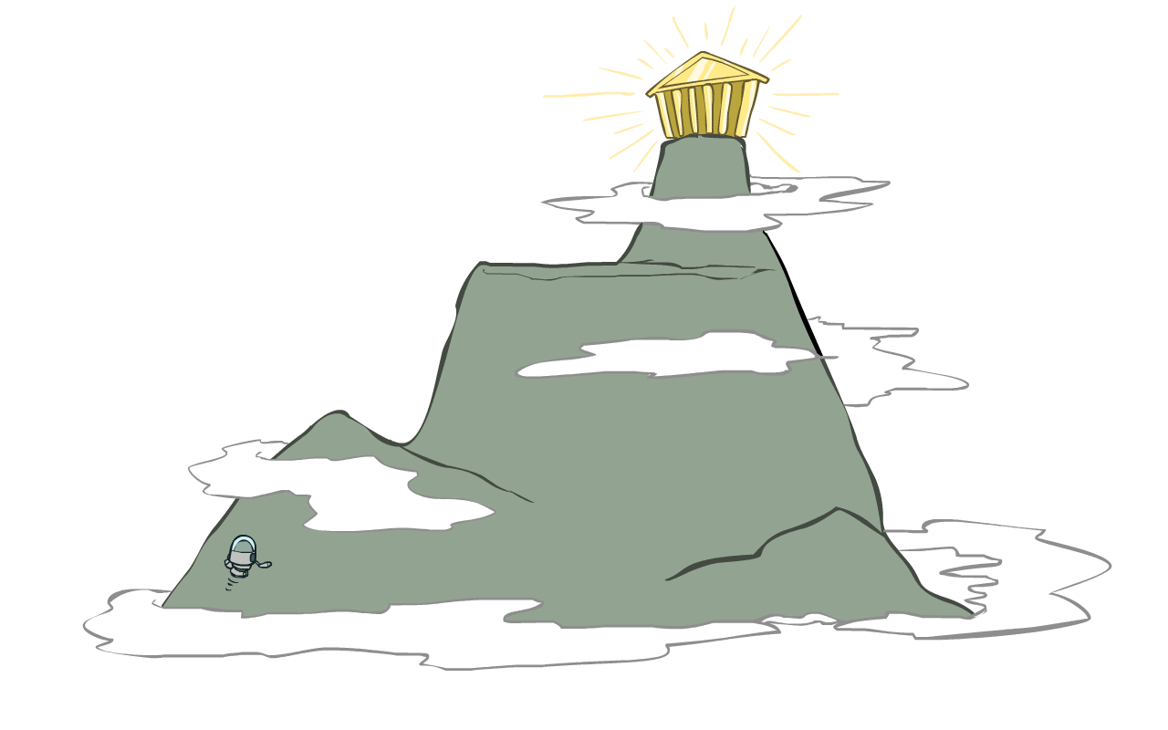
Hill Climbing
Recall from CSPs lecture: simple, general idea
Start wherever
Repeat: move to the best neighboring state
If no neighbors better than current, quit
What’s particularly tricky when hill-climbing for multiclass logistic regression?
Optimization over a continuous space
Infinitely many neighbors!
How to do this efficiently?

Slide 23
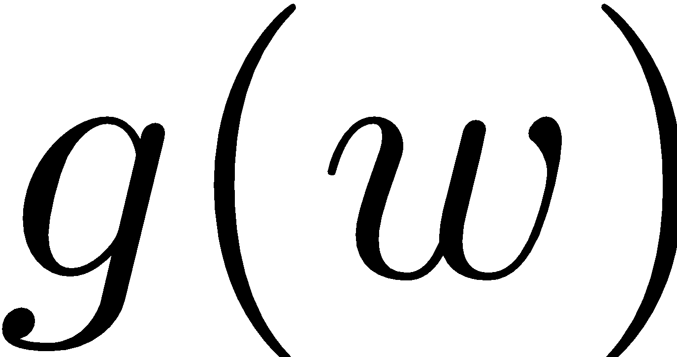
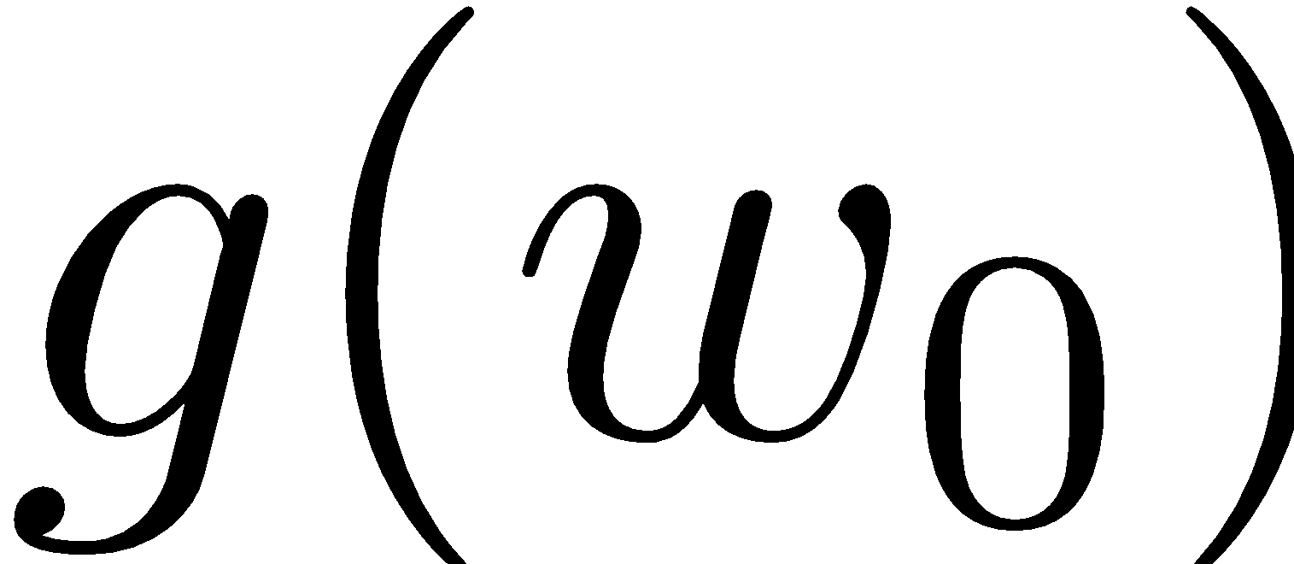


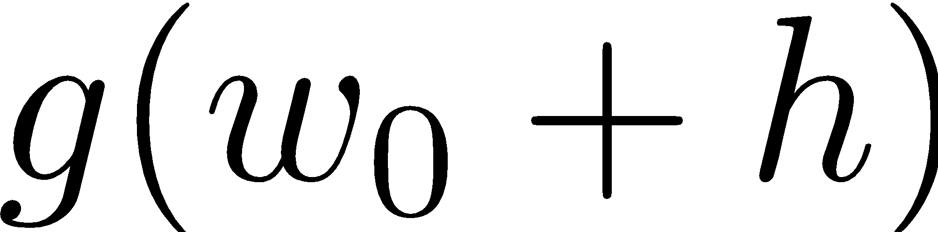
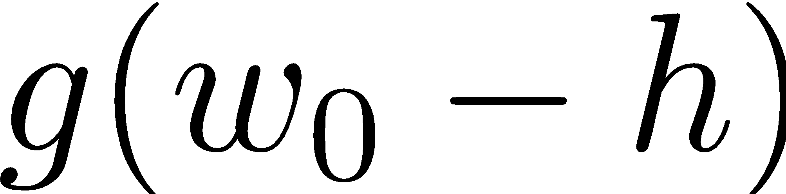
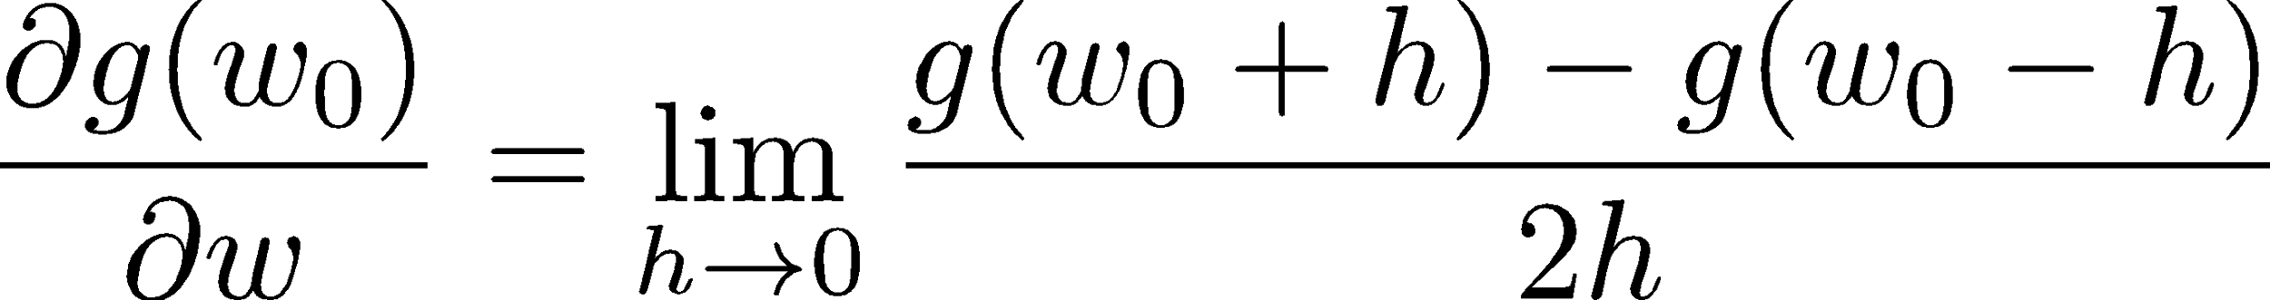
1-D Optimization
Could evaluate and
Then step in best direction
Or, evaluate derivative:
Tells which direction to step into

Slide 24
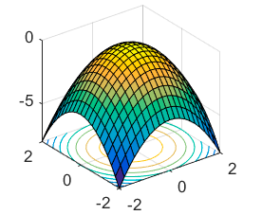
2-D Optimization
Source: offconvex.org

Slide 25
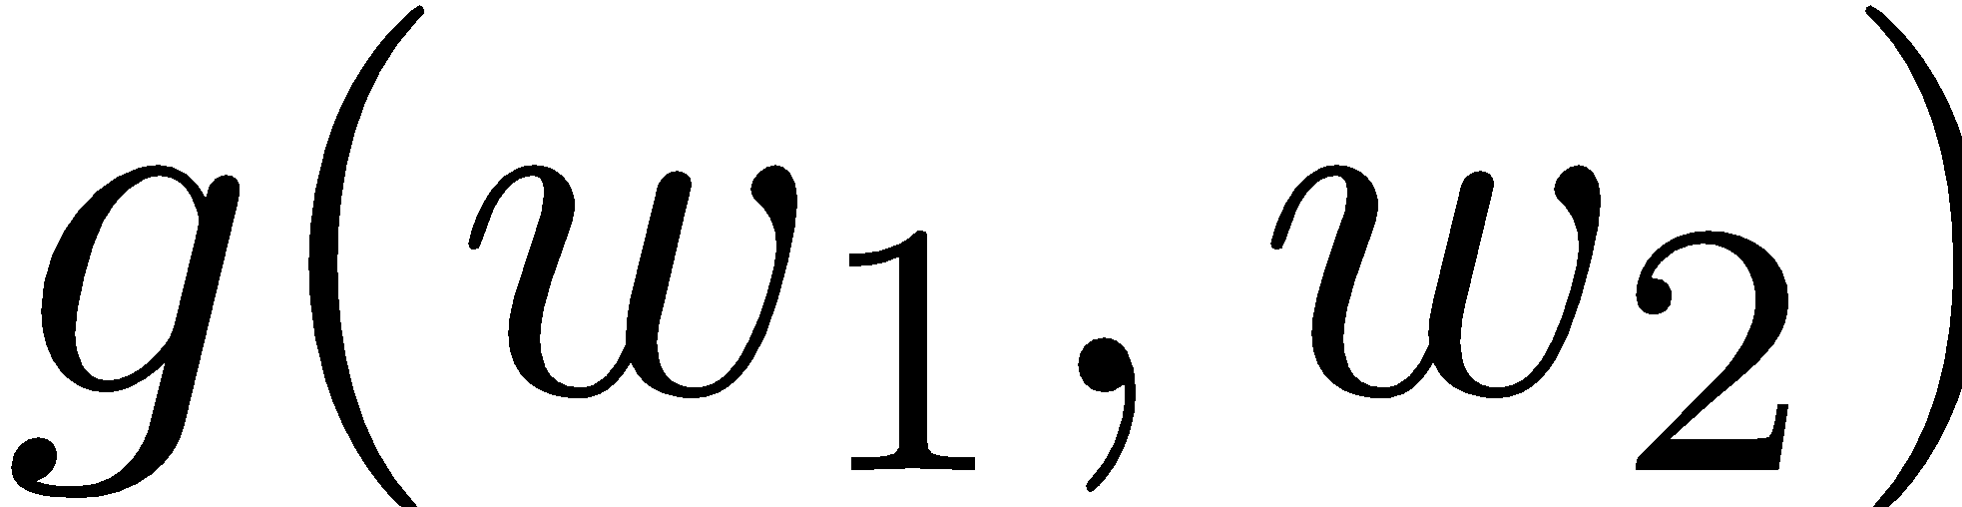
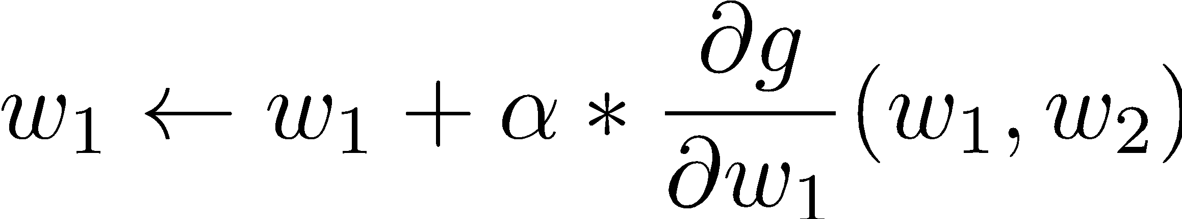
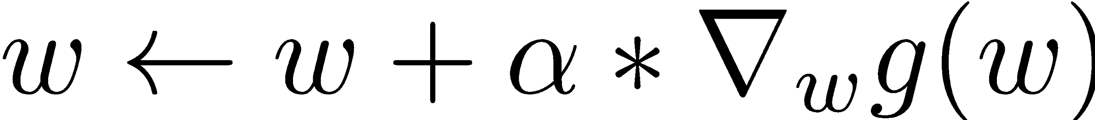
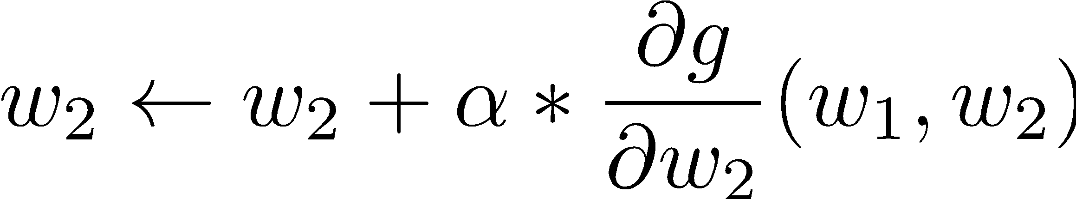
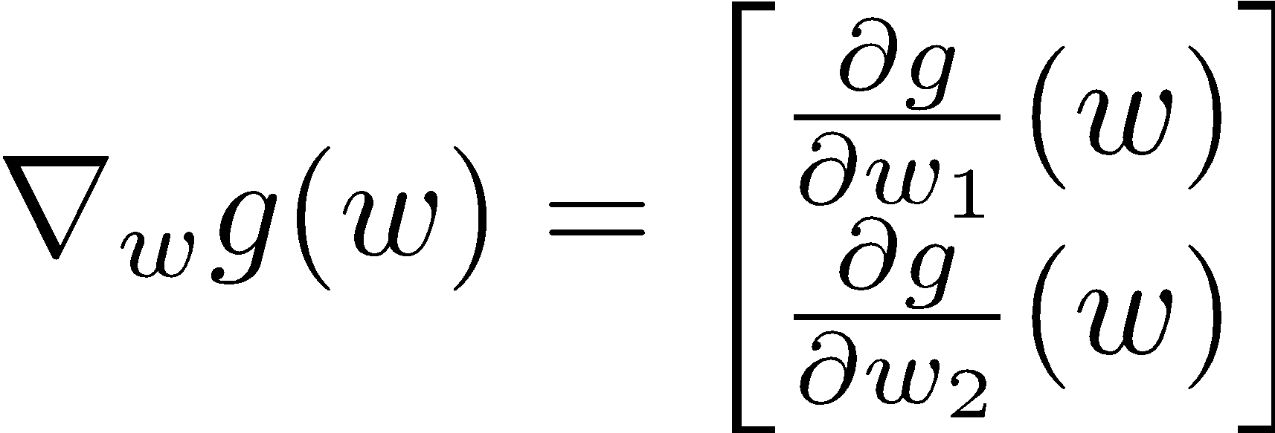
Gradient Ascent
Perform update in uphill direction for each coordinate
The steeper the slope (i.e. the higher the derivative) the bigger the step for that coordinate
E.g., consider:
Updates:
Updates in vector notation:
with:
= gradient

Slide 26
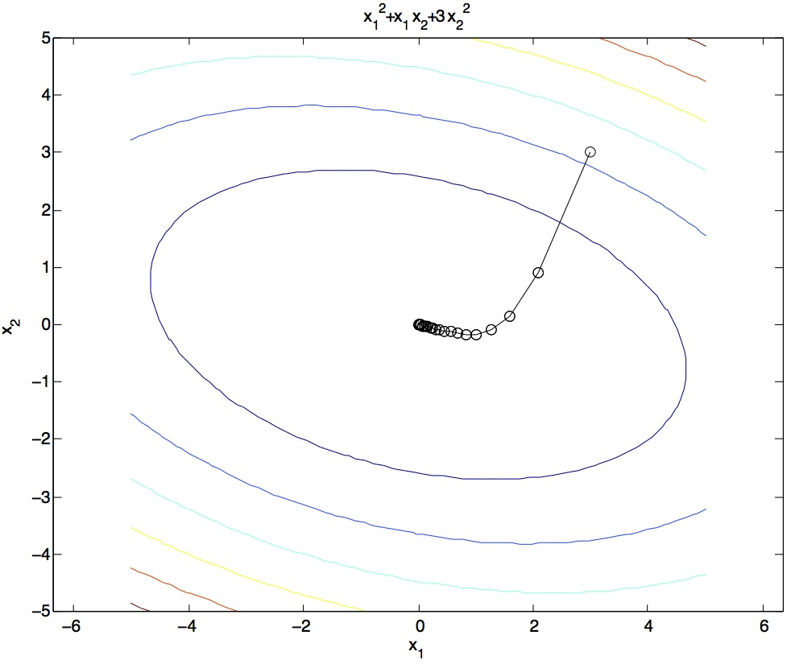
Steepest Descent
Idea:
Start somewhere
Repeat: Take a step in the steepest descent direction
Figure source: Mathworks

Slide 27
Steepest Direction
Steepest Direction = direction of the gradient

Slide 28
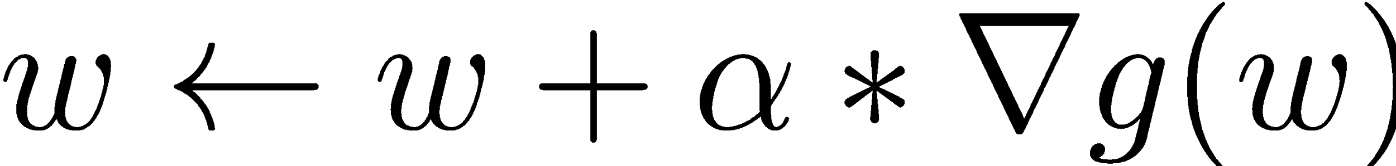

Optimization Procedure: Gradient Ascent
init
for iter = 1, 2, …
: learning rate --- hyperparameter that needs to be chosen carefully

Slide 29
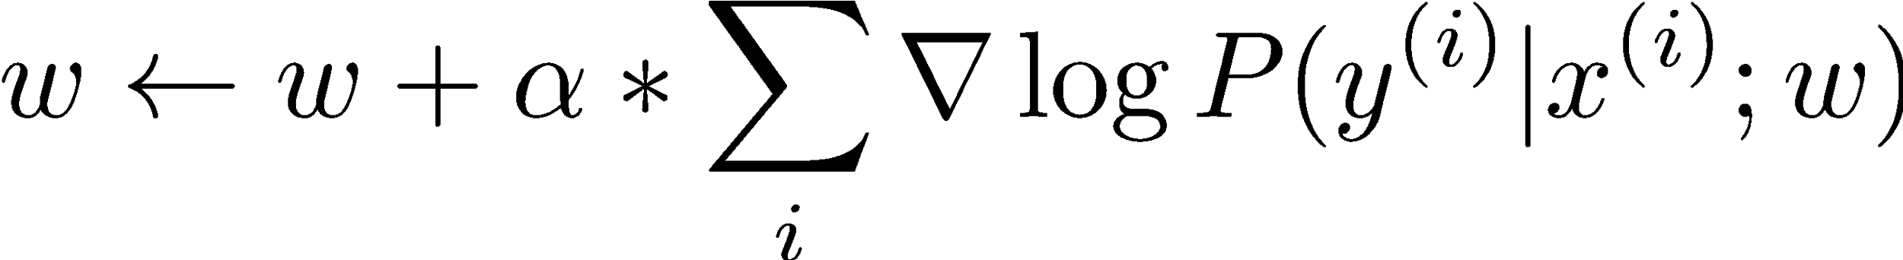
Batch Gradient Ascent on the Log Likelihood Objective
init
for iter = 1, 2, …

Slide 30
Stochastic Gradient Ascent on the Log Likelihood Objective
Observation: once gradient on one training example has been computed, might as well incorporate before computing next one
init
for iter = 1, 2, …
pick random j

Slide 31
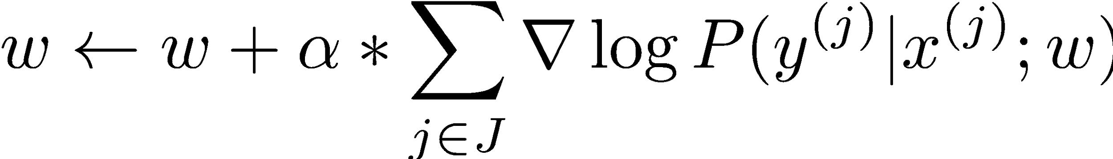
Mini-Batch Gradient Ascent on the Log Likelihood Objective
Observation: gradient over small set of training examples (=mini-batch) can be computed in parallel, might as well do that instead of a single one
init
for iter = 1, 2, …
pick random subset of training examples J

Slide 32
Neural Networks

Slide 33
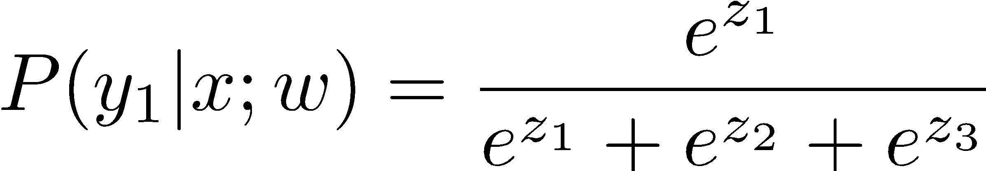
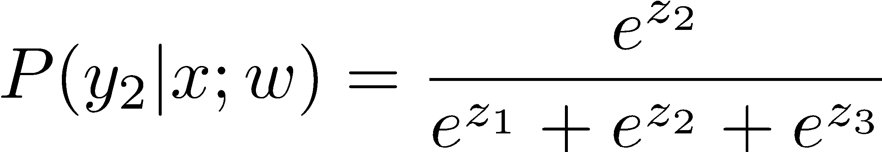
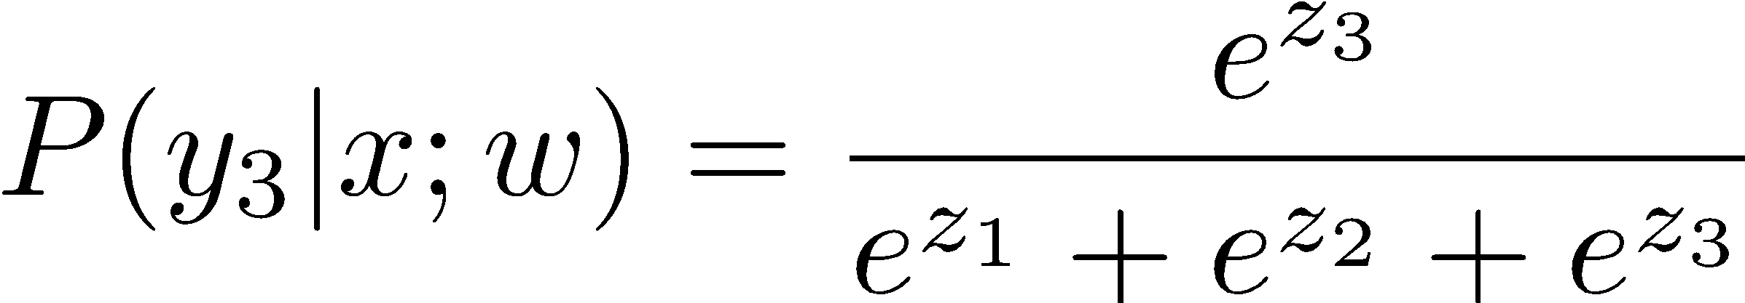
Multi-class Logistic Regression
= special case of neural network
f₁(x)
z₁
softmax
f₂(x)
z₂
f₃(x)
…
z₃
f_{K}(x)

Slide 34
Deep Neural Network = Also learn the features!
f₁(x)
z₁
softmax
f₂(x)
z₂
f₃(x)
…
z₃
f_{K}(x)

Slide 35
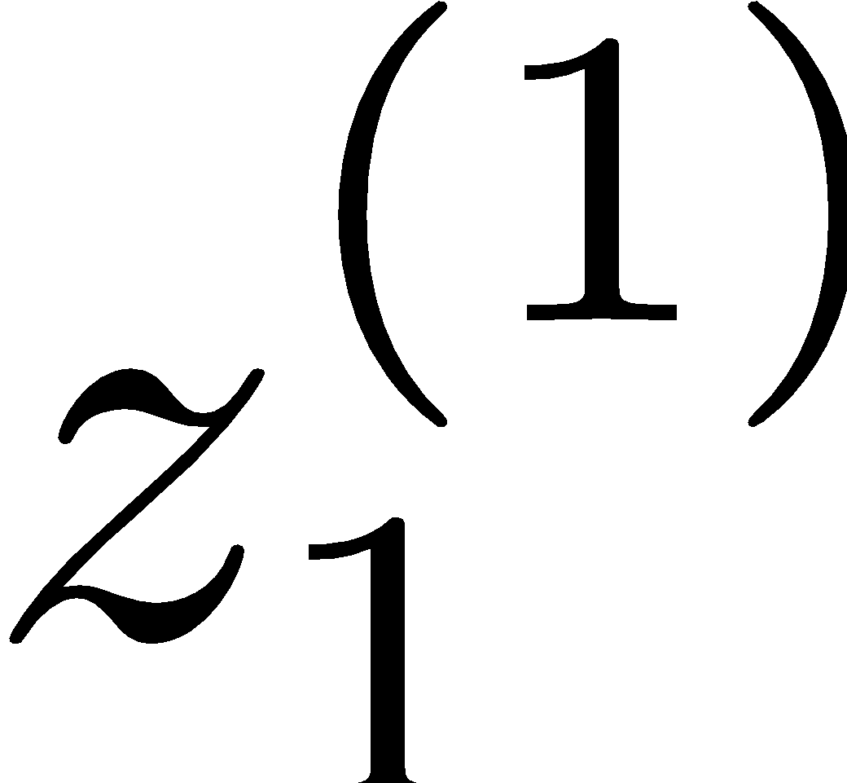
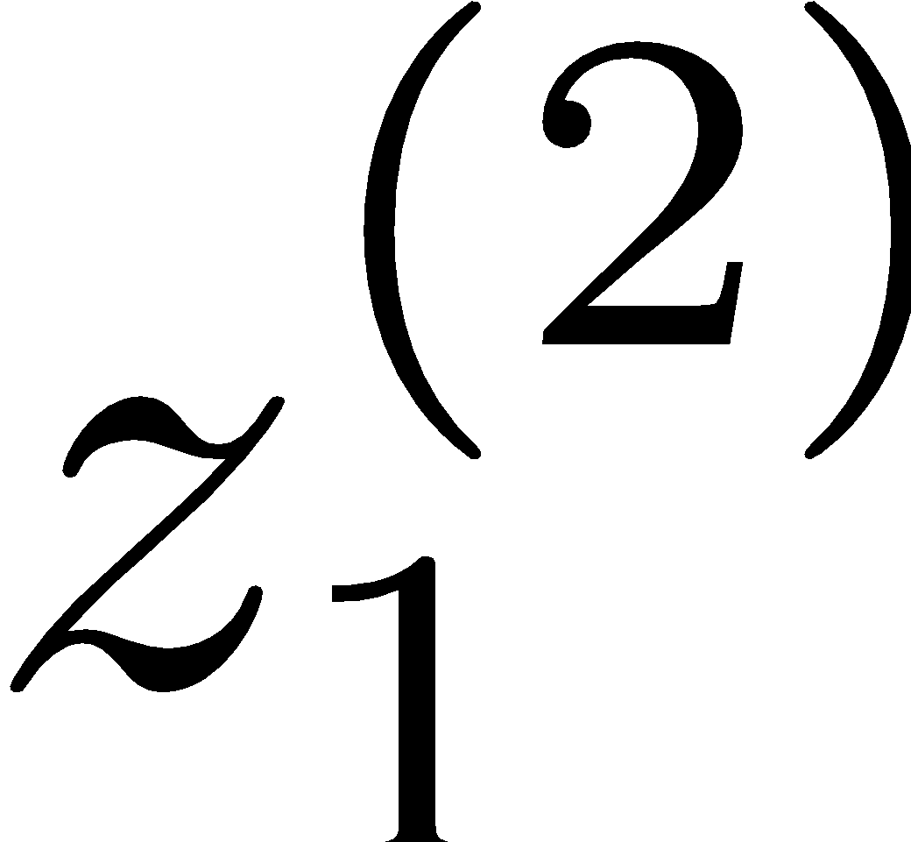
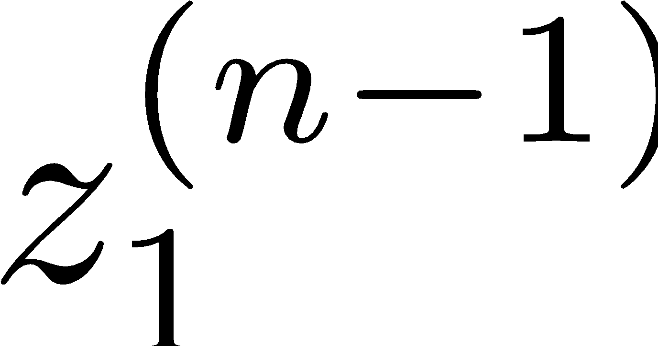
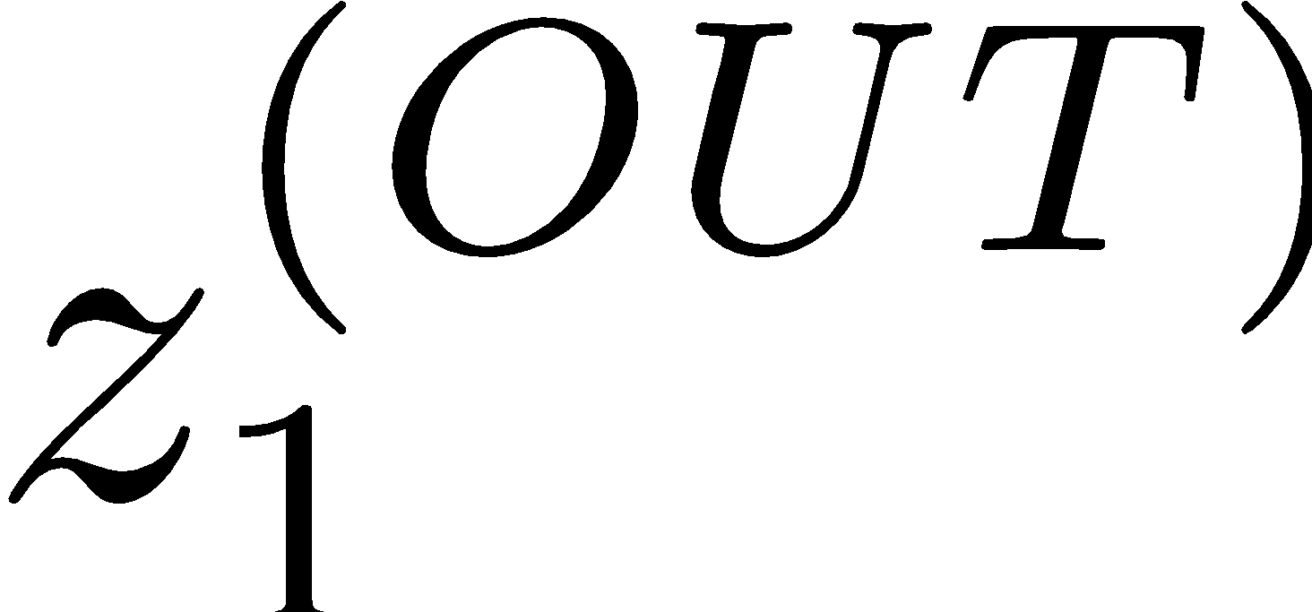
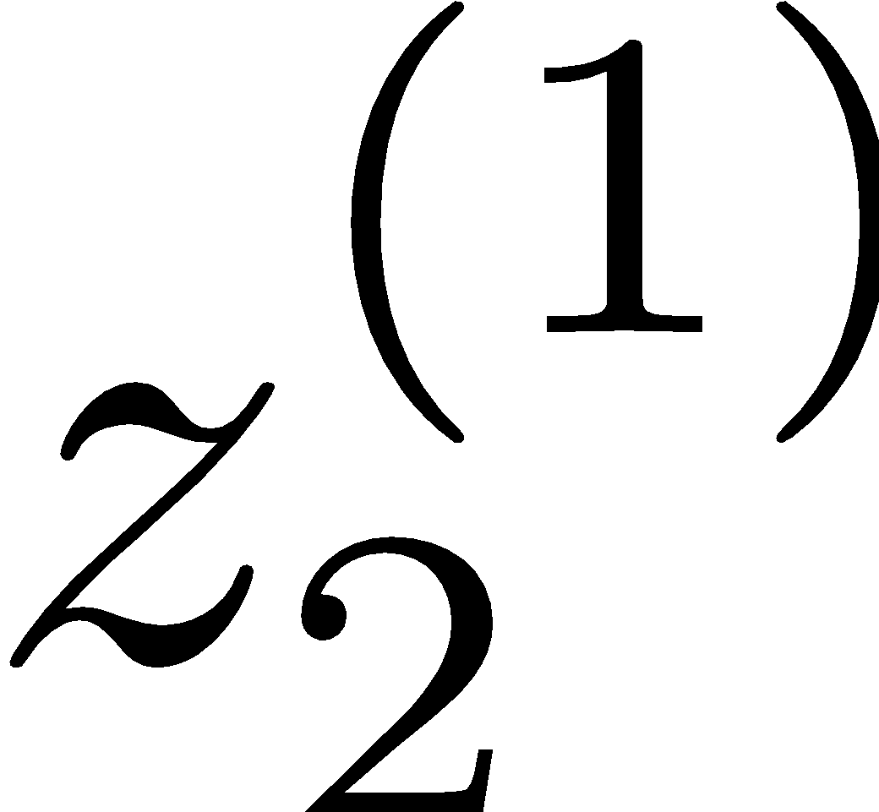
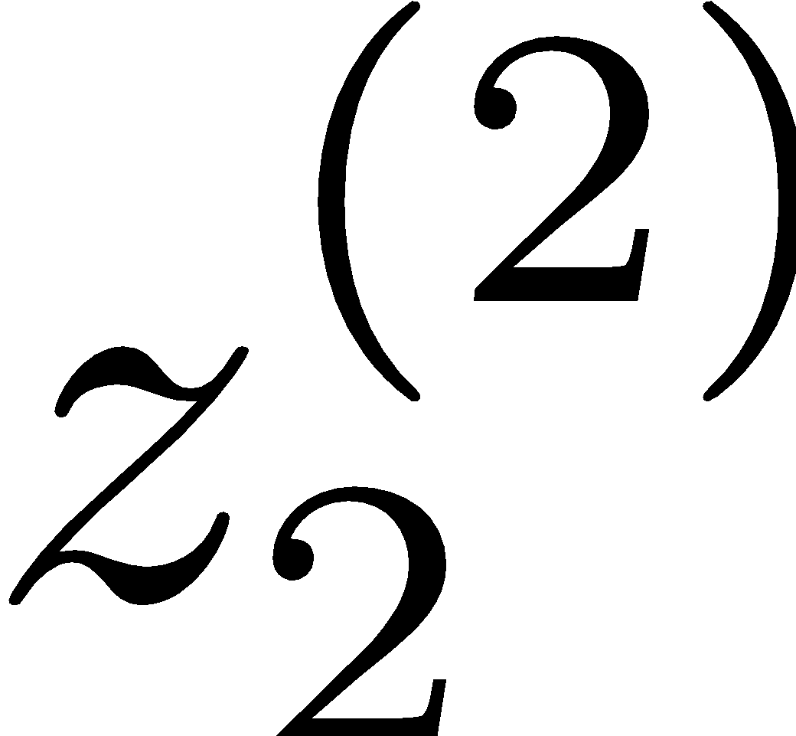














Deep Neural Network = Also learn the features!
x₁
f₁(x)
softmax
x₂
f₂(x)
…
x₃
f₃(x)
…
…
…
…
…
x_{L}
f_{K}(x)
g = nonlinear activation function

Slide 36
Deep Neural Network = Also learn the features!
x₁
softmax
x₂
…
x₃
…
…
…
…
…
x_{L}
g = nonlinear activation function

Slide 37

Common Activation Functions
[source: MIT 6.S191 introtodeeplearning.com]

Slide 38
Deep Neural Network: Also Learn the Features!
Training the deep neural network is just like logistic regression:
just w tends to be a much, much larger vector ☺
just run gradient ascent

